Slide 1


Department of Computer Science and Engineering
CS19P11 – INTERNET OF THINGS ESSENTIALS
AUTOMATIC BUS FARE SYSTEM
HARINI PRABA M (210701069)
JEFFRIN TANIA B
(210701093)

Slide 2
Abstract
Public transportation systems are an essential part of modern urban infrastructure. Millions of people rely on buses as their public transport. However, managing the fare collection process in these systems can be a significant challenge for transportation authorities and operators. To address this challenge the automatic bus fare collection system can be implemented for accurate and efficient way of collecting fares from passengers, reducing the time and cost associated with manual fare collection methods. In this system, GPS technology is used to track the and allows the system to calculate fares based on the distance traveled, ensuring that passengers are charged accurately for their journeys. RFID technology can be used to identify and authenticate passengers, providing seamless and contactless fare collection experience. The objective of an automatic bus fare collecting system using GPS and RFID technology is to improve the efficiency and accuracy of fare collection in public transportation.

Slide 3
Introduction
Automated bus fare collection (ABFC) systems are used in many urban public transport systems around the world. As the designation suggests, these are typically designed with the specific purpose of automating the ticketing system, easing public transport use for passengers and adding efficiency to revenue collection operations. In addition, ABFC systems are used to enable integrated ticketing across different public transport modes and operators in urban areas. This chapter gives you an introduction about the ABFC system and its real time applications. The main idea behind this project is to collect the fare automatically using the RFID and GPS in a cost-efficient manner. Internet of Things allows objects to sensed and controlled remotely across existing network infrastructure.

Slide 4
Literature Survey
S. No. | Title of the paper | Author name | Journal name & year | Inference
1. | Design and Implementation of Bus Intelligent Fare Collection System Based on GPS and RFID | Hu, W., & Yin, Y. (2018) | Conference Series, 1063(3), 032050. | This evaluates the system's performance through experiments and provide insights into the benefits and challenges of using this technology in public transportation.
2. | An Automatic Fare Collection System for Buses Based on GPS and RFID | Zhang, C., Yang, Y., & Jiang, Z. (2019) | Applied Sciences, 9(13), 2787 | This article describes an automatic fare collection system for buses based on GPS and RFID technologies.
3. | The Study of Bus Intelligent Fare Collection System Based on RFID and GPS Technology | Ding, L., & Liu, J. (2017) | Conference Series, 835(1), 012046 | This presents a study of a bus intelligent fare collection system.
4. | Research on Intelligent Fare Collection System of Public Transit Based on GPS and RFID Technology. | Zhang, J., Wu, J., & Deng, Z. (2017) | International Journal of Online Engineering, 13(10), 56-66. | Individual trip destination estiomation.

Slide 5
S. No. | Title of the paper | Author name | Journal name & year | Inference
5. | A Study on the Bus Fare Collection System Based on RFID and GPS Technology | Wang, H., & Zhang, J. (2017) | International Journal of Emerging Technology and Advanced Engineering, 7(11), 410-415. | Cost estimation of tickets
6. | Design and Implementation of Bus Intelligent Fare Collection System Based on RFID and GPS | Li, Y., Li, S., & Zhang, H. (2019) | Conference Series, 1205(3), 032008. | Automatic data collection systems
7. | Research on Bus Fare Collection System | Zhao, Y., Wang, Z., Chen, J., & Jia, H. (2019) | In 2019 3rd International Conference on Management Science and Innovative Education (MSIE) (pp. 142-145) | Validating travel behiour

Slide 6
S. No. | Title of the paper | Author name | Journal name & year | Inference
8. | The Development of a GPS and RFID-Based Automatic Fare Collection System for Public Transit | Chao, C. F., Wu, J. Y., & Chen, K. H. (2019). | Journal of Advanced Transportation, 2019, 1-13. | Analysis using automated data collection system
9. | Design and Implementation of a Bus Intelligent Fare Collection System | Tang, X., Zheng, Y., Yang, D., Zhang, X., & Lu, W. (2018) | Sensors, 18(10), 3268. | Automatic fare collection data to estimate linked transit trips.
10. | An Intelligent Bus Fare Collection System using RFID and GPS Technology. | Rajagopal, R., & Harish, M. R. (2018) | International Journal of Innovative Technology and Exploring Engineering, 7(6), 18-22. | Constructing an automatic bus destination matrix

Slide 7
Problem statement and Proposed work
Developing an automatic bus fare system using IoT involves creating a seamless, efficient solution for fare collection and management on buses. This project aims to eliminate manual fare collection processes by implementing sensors and communication technologies to track passengers boarding and disembarking. The system should accurately calculate fares based on distance traveled or fixed rates, provide real-time fare information to passengers and authorities, and offer secure payment options. The primary challenge lies in designing a robust, reliable hardware and software infrastructure that can withstand varied environmental conditions and handle high volumes of transactions without errors. Additionally, ensuring data privacy and security are critical aspects to address in the development process.

Slide 8
The proposed work for the automatic bus fare system in the IoT project includes designing and implementing sensor-based systems for passenger tracking, developing a secure payment gateway for fare transactions, integrating real-time communication modules for data transfer, creating a user-friendly interface for passengers to check fares and make payments, testing the system extensively under different conditions to ensure reliability, and deploying the system on buses for field trials and evaluation.

Slide 9


BLOCK
DIAGRAM
pppo
POWER SUPPLY
RFID
ARDUINO
UNO
LCD
GPSGPS MODULE
MODULE

Slide 10
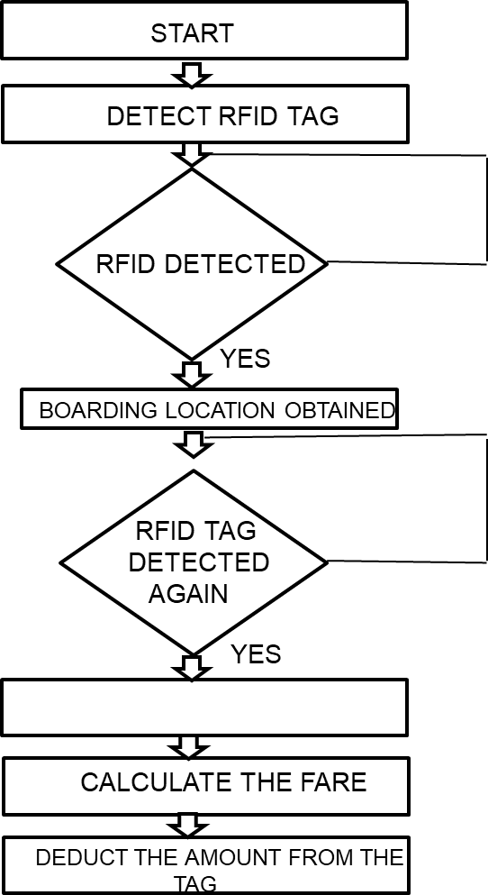
Proposed System

Slide 11
Methodology
In Recent advancements in various technologies have made remarkable developments in various fields for public welfare and public transport is one such area. In near a future public transport bus system with advanced technologies like Radio Frequency Identification Device (RFID), and RF modules will gain spotlight due to their advantage of higher convenience and greater life standards as compared to the conventional bus systems. The study brings out improved solution in terms of cost, convenience, user satisfaction and future implementation.This implementation is aimed at a real time usage of Automatic Fare Collection system and does not compromise on the security.

Slide 12
It guarantees us that the proposed project is simple, efficient and cost effective.
RFID has been an emerging technology in recent years. RFID consists of two components, RFID Tag and RFID Reader. RFID Tag contains information such as name, address and mobile number. RFID reader reads the above information from the RFID Tag. IR sensor is used to count the number of persons entering into the bus. Internet of Things define the concept of network devices to sense and collect
data from the world around us, and then share that data across the Internet.

Slide 13
Results and Discussions
An automatic bus fare collection system using GPS and RFID works by utilizing two technologies: Global Positioning System (GPS) and Radio Frequency Identification (RFID).
GPS technology is used to track the location of the bus and determine the fare based on the distance travelled by the passenger. RFID technology is used to identify the passenger and deduct the fare from their account.

Slide 14
Conclusion
The manual fare collection system has many issues which are overcome by our proposed system. Automated fare collection system for public transport using GPS is an innovative idea which reduces man power. The manual fare collection system has many issues which are overcome by our proposed system. Automated fare collection system for public transport is an innovative idea which reduces man power. It is believed that by implementation of these system problems such as underutilization of buses fleet will be reduced.

Slide 15
References
“Accurate Global Localization Using Visual Odometry and Digital Maps on Urban Environments” Ignacio Parra Alonso, David Fernandez Llorca, Member, IEEE, Miguel Gavilan, Sergio Alvarez Pardo, Miguel Angel GarciaGarrido, LjuboVlacic, and Miguel Angel Sotelo, Member, IEEE.
“Bus-Stop Control Strategies Based on Fuzzy Rules for the Operation of a Public Transport System” Freddy Milla, Member, IEEE, Doris Saez, Senior Member, IEEE, Cristian E. Cortes, and Aldo Cipriano, Senior Member, IEEE.
Enhancing the Experience of Public Transport Users with Urban Screens and Mobile Applications” M. Foth and R. Schroeter Proc.14th Int’l Academic Mind Trek Conf.: Envisioning Future Media Environments (Mind Trek 10), ACM, 2010, pp. 33–40.
“Leveraging Electronic Ticketing to Provide Personalized Navigation in a Public Transport Network” Ana Aguiar, Member, IEEE, Francisco Maria Cruz Nunes, Manuel Joao Fernandes Paula Alexandra Silva, and Dirk Elias.
“Mobile Ticketing System for Automatic Fare Collection Model for Public Transport” Chandra, DekaGanesh ;Prakash Ravi ; Lamdharia, swati

Slide 16
Thank You

